Slide 1
PRESENTATION
Quantum Kernel –
Quantum Machine Learning
By Chirag Jain
Guided By:-
Asst. Prof. Mrs Jayshree Patel

Slide 2
Content
Introduction
What is Quantum Machine Learning ?
Components of Quantum Machine Learning
Architecture of Quantum Machine Learning
Quantum Kernel
Types of Quantum Kernel
How Quantum Kernel Works
Advantages of Quantum Kernel
Technology use in Quantum Machine Learning
Applications of Quantum Machine Learning
Advantages and Disadvantagesof Quantum Machine Learning
Future of Quantum Kernel and QML
References

Slide 3
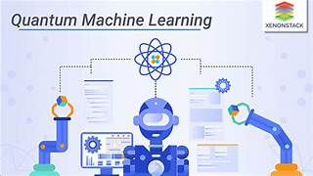
Introduction
Quantum Machine Learning is the integration of quantum computing with machine learning to create faster and more powerful learning algorithms.
Quantum Machine Learning (QML) is an emerging interdisciplinary field that combines Quantum Computing and Machine Learning.
It explores how quantum computers can be used to improve the speed, efficiency, and capability of machine learning algorithms.

Slide 4
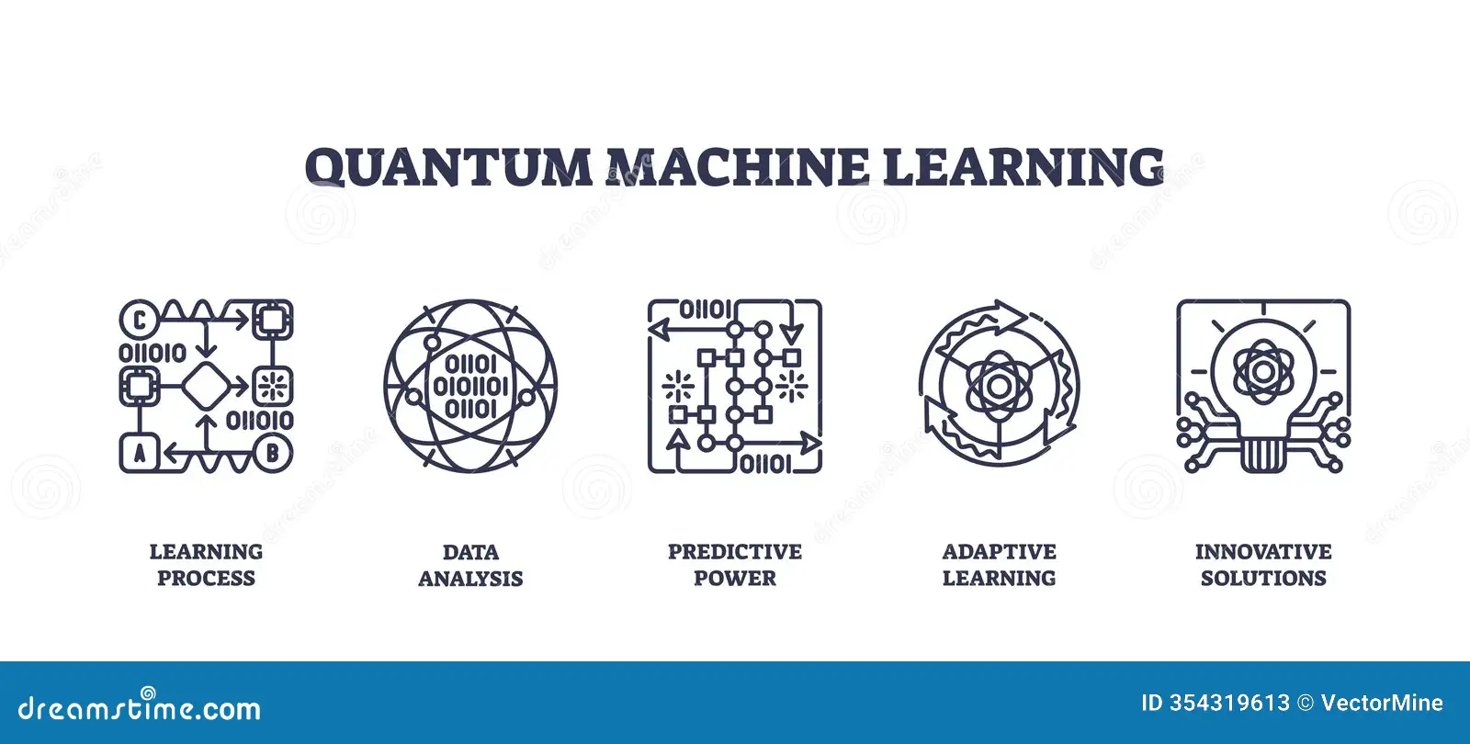
What is Quantum Machine Learning ?
QML = Machine Learning + Quantum Physics
Quantum Machine Learning is a field that combines Quantum Computing and Machine Learning (ML) to build smarter, faster algorithms for data analysis, pattern recognition, and prediction
Quantum Machine Learning = Machine Learning algorithms that run on quantum computers or use quantum principles.
Quantum Machine Learning runs (fully or partially) on quantum computers using qubits, which can be:
0 and 1 , Both 0 and 1 at the same time (called superposition)
This gives quantum computers the potential to process huge amounts of data much faster.

Slide 5
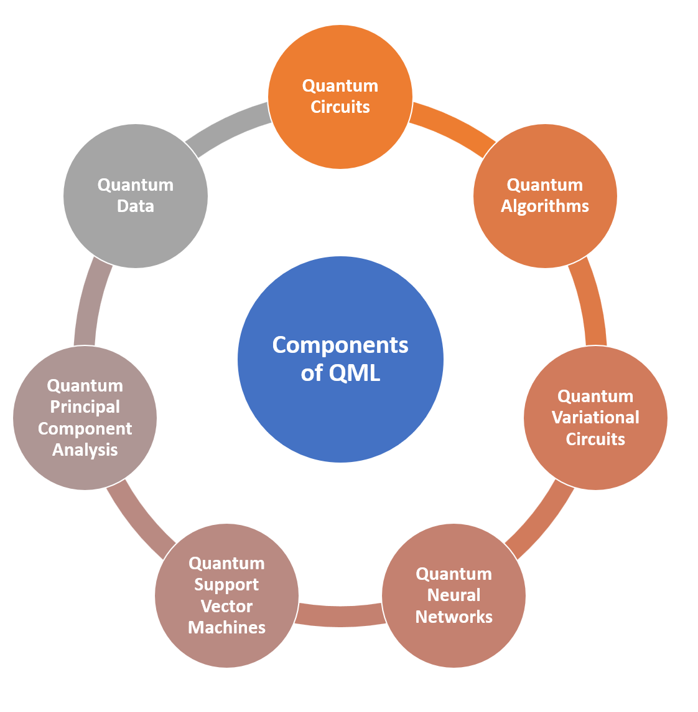
Components of Quantum Machine Learning
Quantum Data Encoding (Feature Mapping)
Qubits & Quantum States
Quantum Circuits
Quantum Algorithms
Quantum Support Vector Machines
Quantum Principal Components Analysis
Variational Quantum Circuits
Quantum Classical Optimizer
Quantum Teleportation
Quantum Sensing and Metrology
Quantum Hardware / Simulator

Slide 6
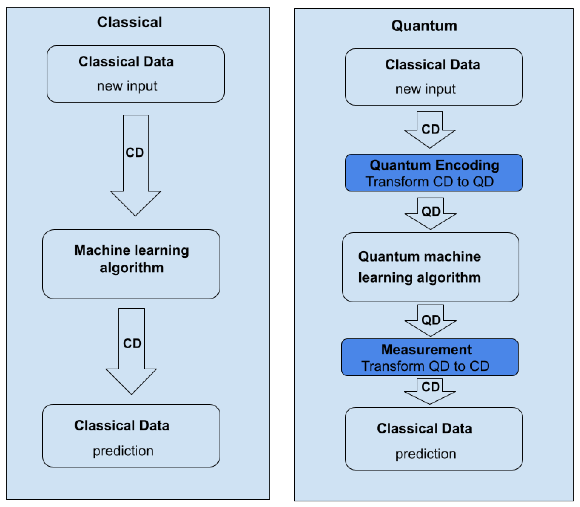
Architecture of Quantum Machine Learning
Classical Data → Input like images, numbers, text.
Preprocessing → Scaling, feature selection, normalization.
Quantum Data Encoding → Map classical data to qubit states.
Quantum Circuit → Process data using gates and entanglement.
Measurement → Convert quantum states back to classical probabilities.
Classical Optimization → Update parameters (θ) using classical optimizer.
Feedback Loop → Iteratively improve model accuracy

Slide 7
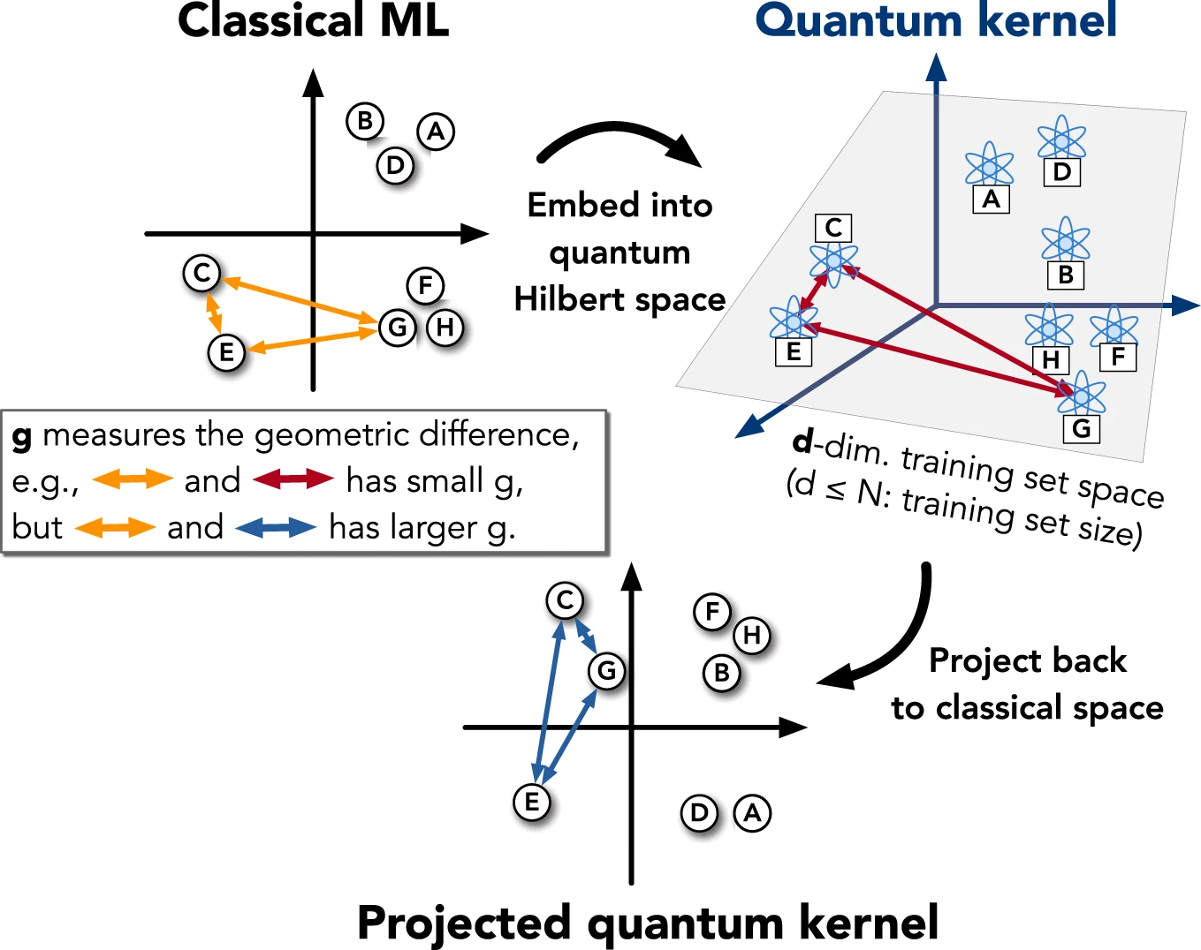
Quantum Kernel
A Quantum Kernel is a mathematical function used in quantum machine learning to measure the similarity between two data points by encoding them into quantum states and computing their overlap.

Slide 8
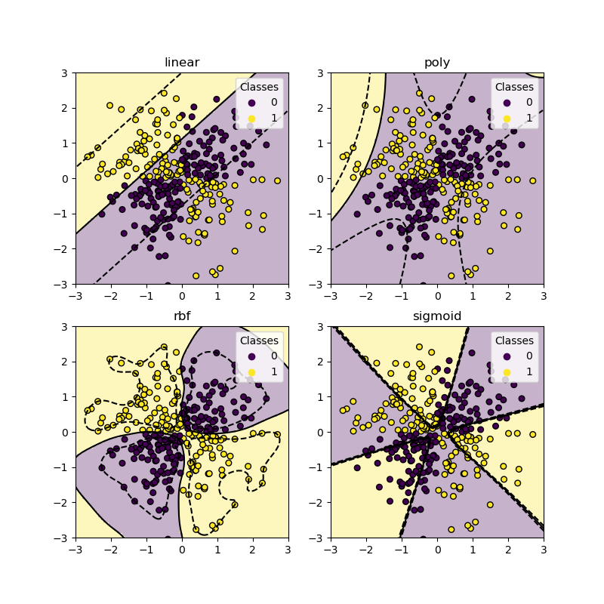
Types of Quantum Kernel

Slide 9
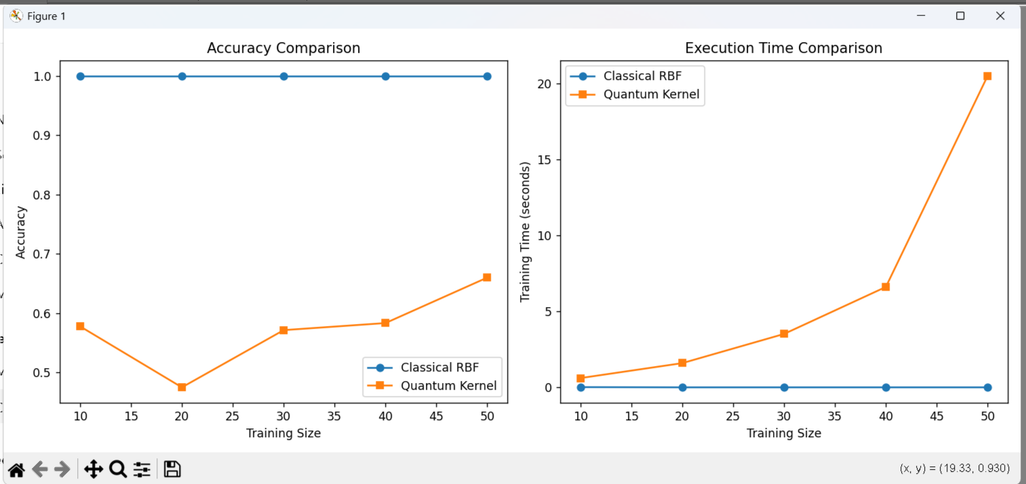
How Quantum Kernel Works

Slide 10
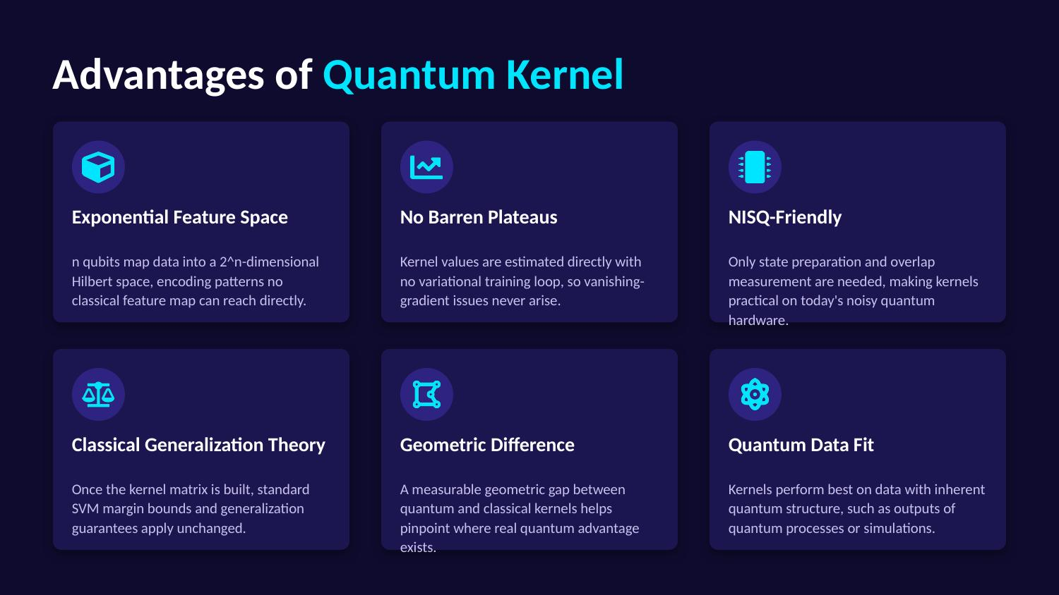
Advantages of Quantum Kernel

Slide 11
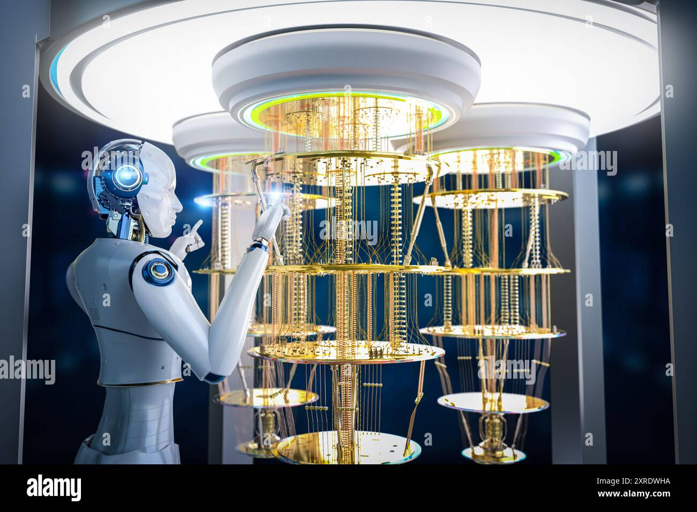
Technology use in Quantum Machine Learning
Quantum Computing Hardware
Quantum Gates & Circuits
Quantum Algorithms for ML
Hybrid Quantum–Classical Computing
Quantum Programming Frameworks
Classical Machine Learning Libraries
Data Encoding Techniques
Quantum Simulators
Quantum Cloud Platforms
Error Mitigation & Noise Handling

Slide 12
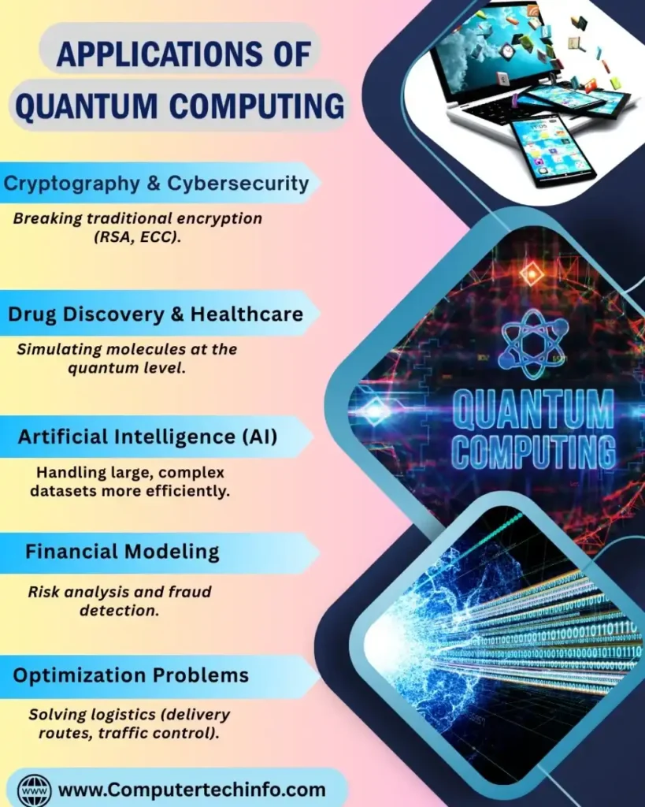
Applications of Quantum Machine Learning
o Optimization Problems
o Drug Discovery & Molecular Modeling
o Financial Modeling & Risk Analysis
o Image & Pattern Recognition
o Natural Language Processing (NLP)
o Cybersecurity
o Artificial Intelligence Acceleration
o Climate & Weather Modeling
o Traffic Optimization

Slide 13

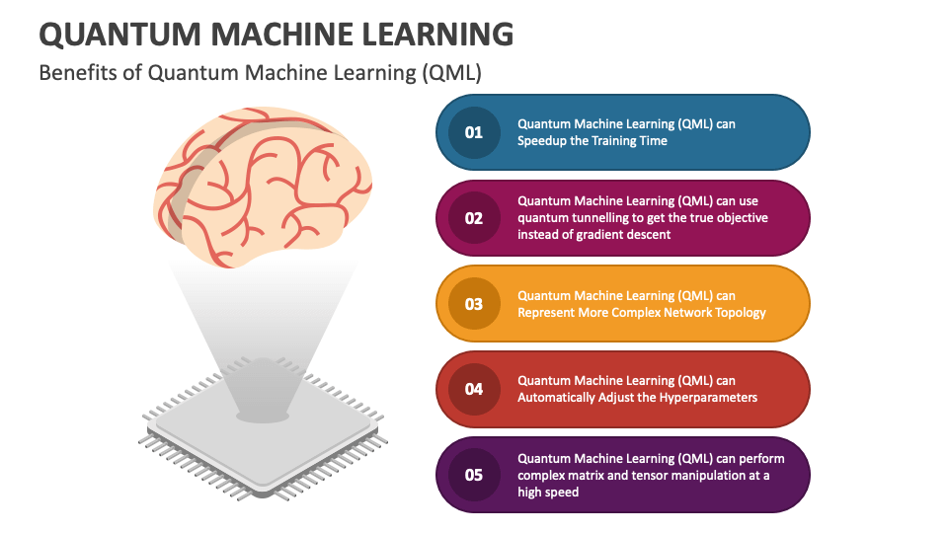
Advantages of Quantum Machine Learning
Exponential Speed-up for Certain Problems
Efficient Handling of High-Dimensional Data
Improved Optimization Capabilities
Faster Pattern Recognition
Enhanced Feature Space Mapping
Potential Energy Efficiency
Solving Classically Intractable Problems
Advancement in AI Research
Ethical and Security Implications
Resource Requirements
Educational and Workforce Development

Slide 14
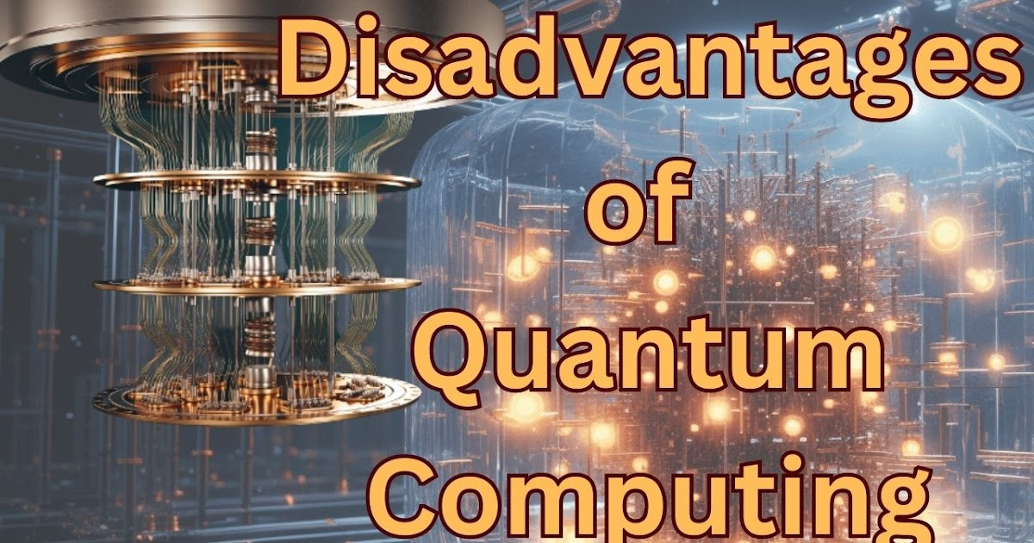
Disadvantages of Quantum Machine Learning
Extremely High Cost
Lack of Skilled Professionals
Limited Practical Applications
Error Sensitivity
Limited Scalability
hortage of Skilled Experts
Limited Real-World Applications
Difficult Algorithm Design
Dependency on Classical Systems
Lack of Standardization

Slide 15
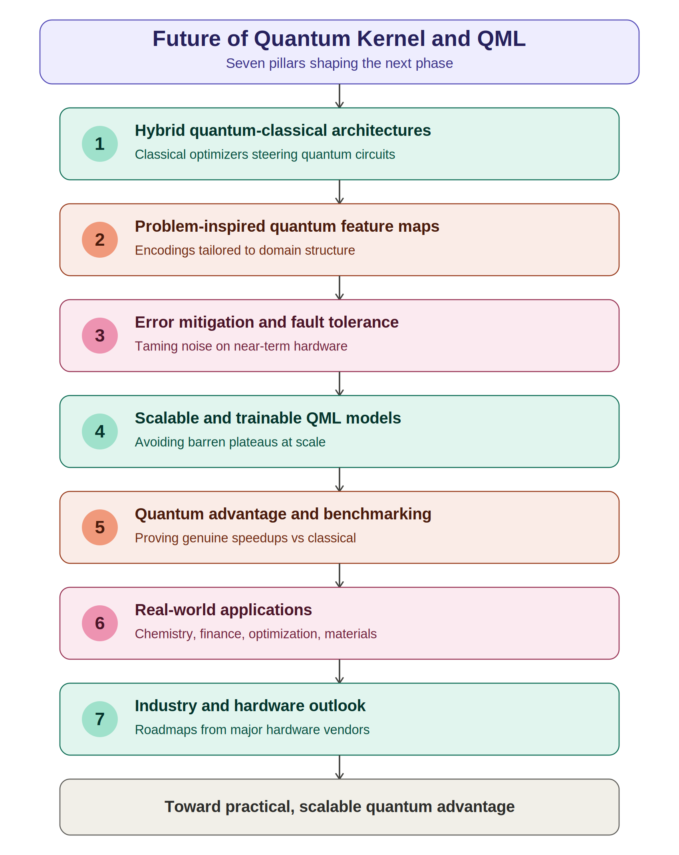
Future of Quantum Kernel & QML

Slide 16
References
https://qiskit.org/documentation
https://quantum.ibm.com/learn
https://quantumai.google
https://www.tensorflow.org/quantum
https://pennylane.ai
https://azure.microsoft.com/products/quantum
https://www.dwavesys.com
https://www.xanadu.ai
Books:-
Wittek, P.. Quantum Machine Learning: What Quantum Computing Means to Data Mining. Academic Press.
Schuld, M., & Petruccione, F.. Machine Learning with Quantum Computers. Springer.

Slide 17
Thank you

